Slide 1
Photomicrographs of Plant foods
Peach
Permission to reproduce original photomicrographs used to make this collection may be obtained from
Dr. David O. Norris at
david.norris@colorado.edu

Slide 2
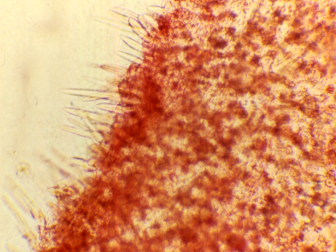
Notes:
350.Prunus persica (L.) Batsch Peach. Surface showing trichomes, stained with safranin, 10X.

Slide 3
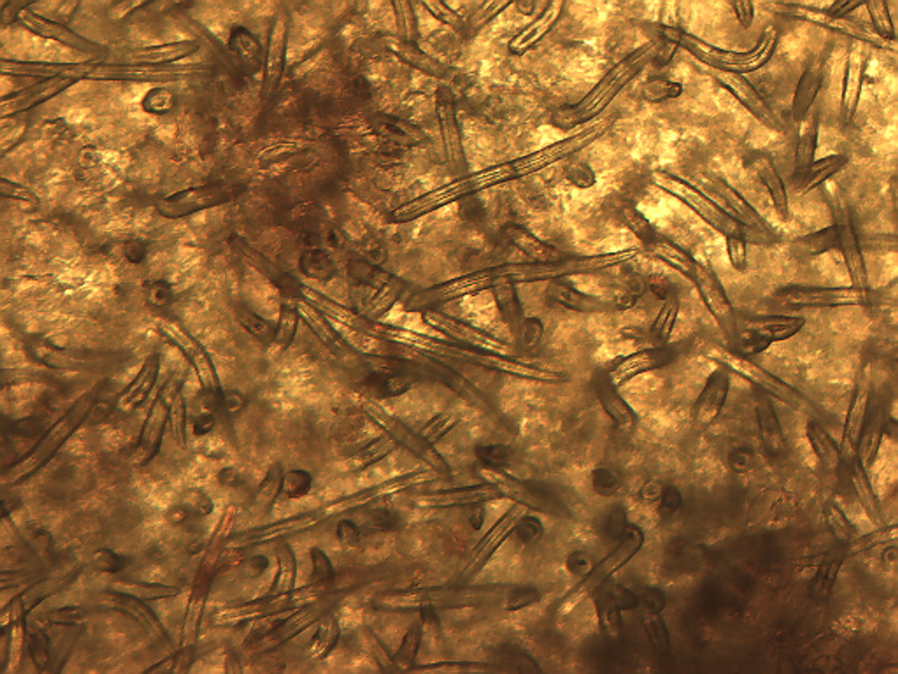
Notes:
351. Peach. Surface of skin showing numerous trichomes (“peach fuzz”), stained lightly with safranin, 10X.

Slide 4
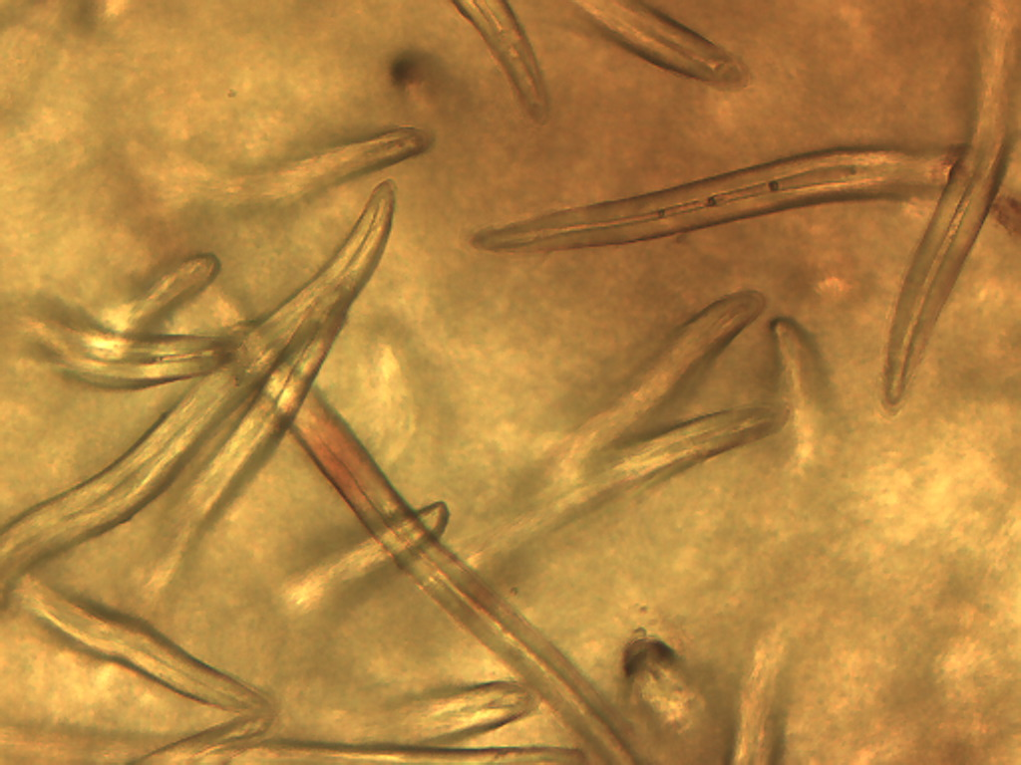
Notes:
352. Peach. Surface (skin) trichomes, 25X.

Slide 5
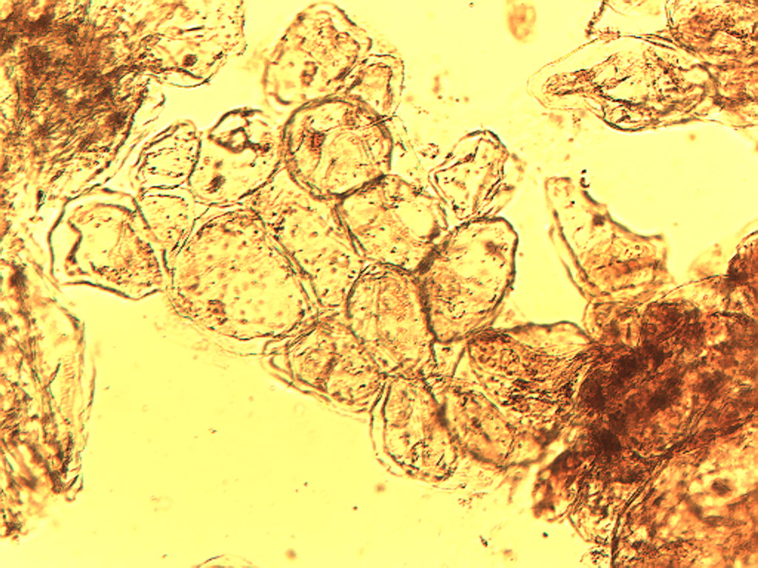
Notes:
353. Peach. Parenchymal cells in peach pulp, stained with safranin, 10X.

Slide 6
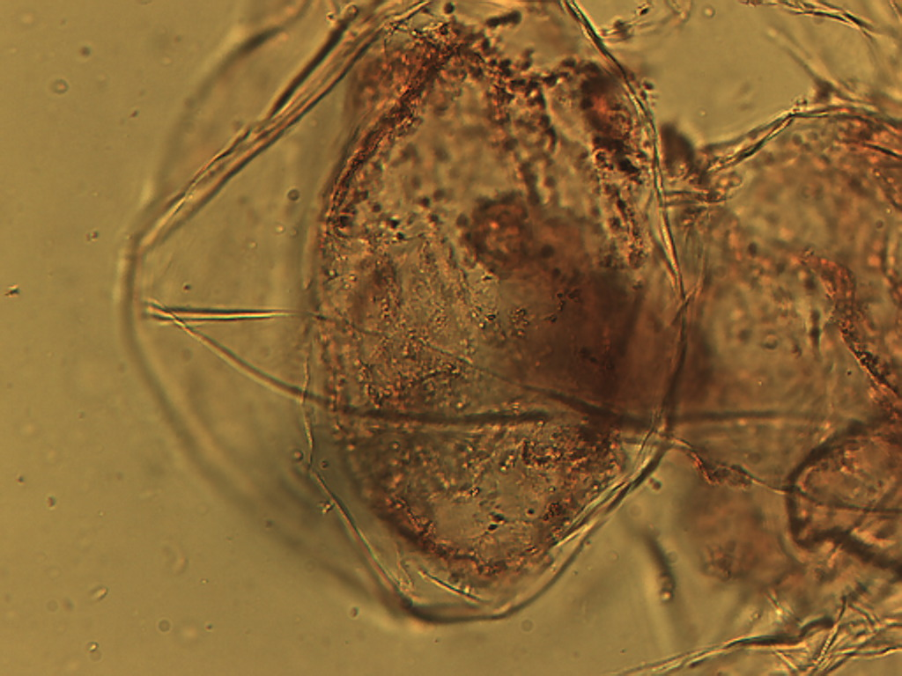
Notes:
354. Peach. Large parenchymal cell stained with safranin, 25X

Slide 7
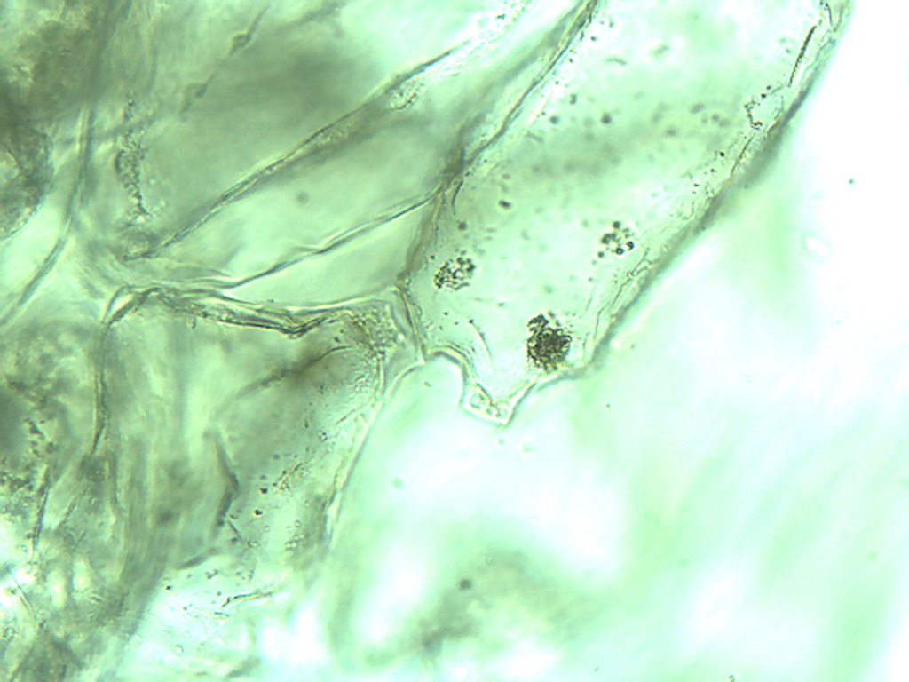
Notes:
355. Peach. Large parenchymal cell with crystal, 25X.

Slide 8
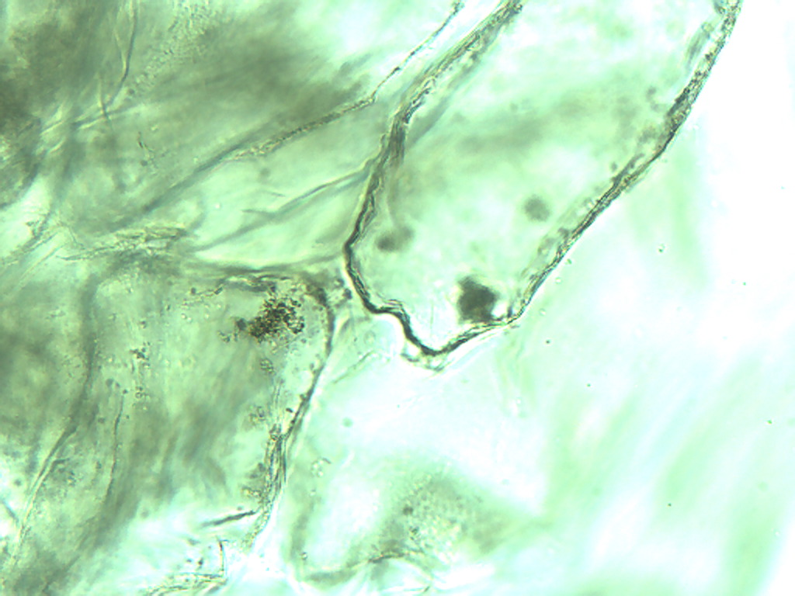
Notes:
356. Peach. Large parenchymal cell with crystal, 25X.

Slide 9
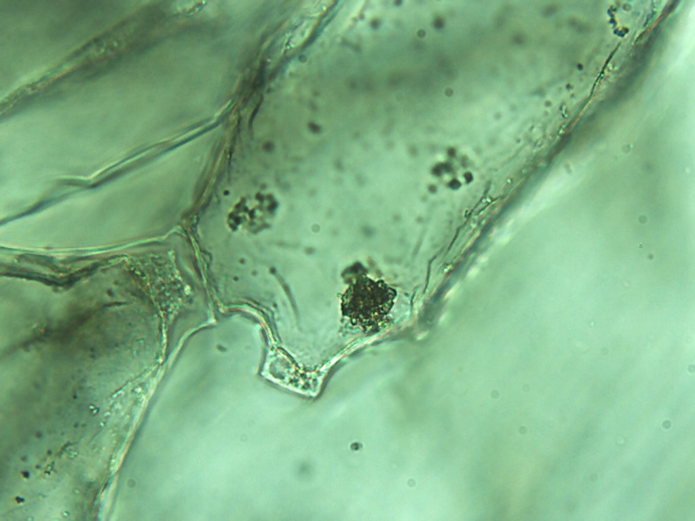
Notes:
357. Peach. Large parenchymal cell with crystal, 40X.

Slide 10
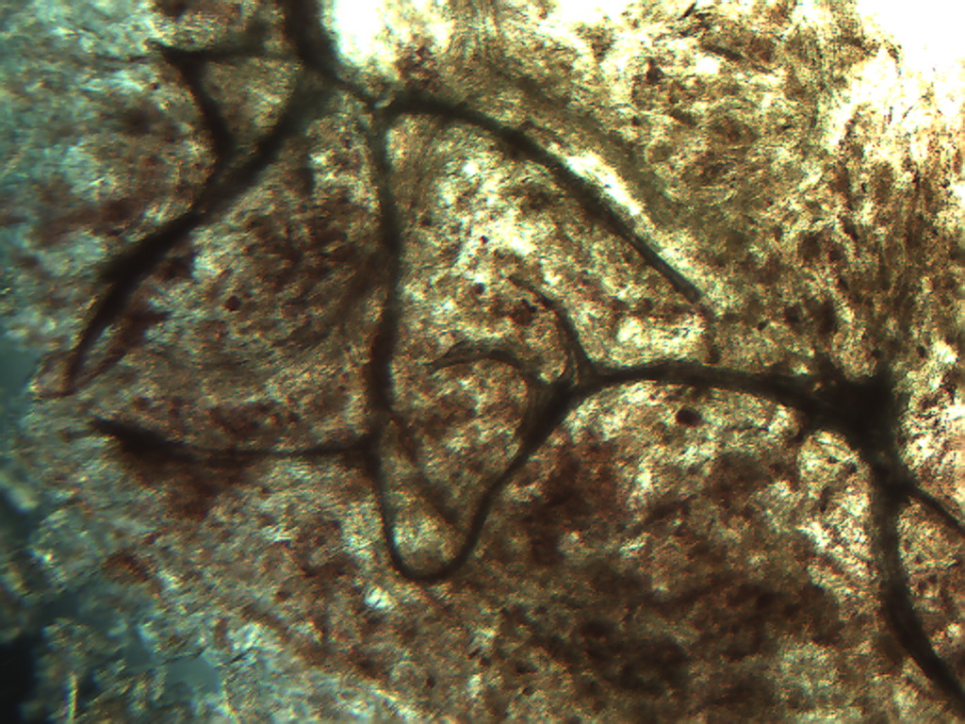
Notes:
358. Peach. Vascular tissue in pulp, 4X.

Slide 11
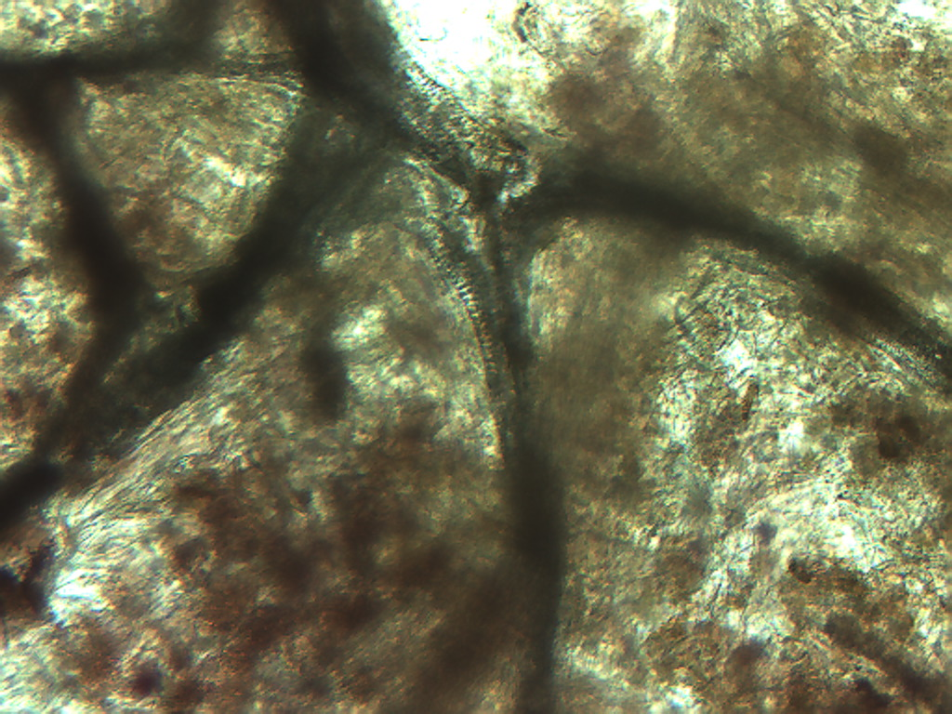
Notes:
359. Peach; vascular tissue in pulp, 10X

Slide 12
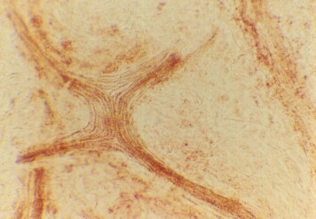
Notes:
360. Peach. Vascular tissue in pulp stained with safranin, 10X; compare with apricot.

